Slide 1
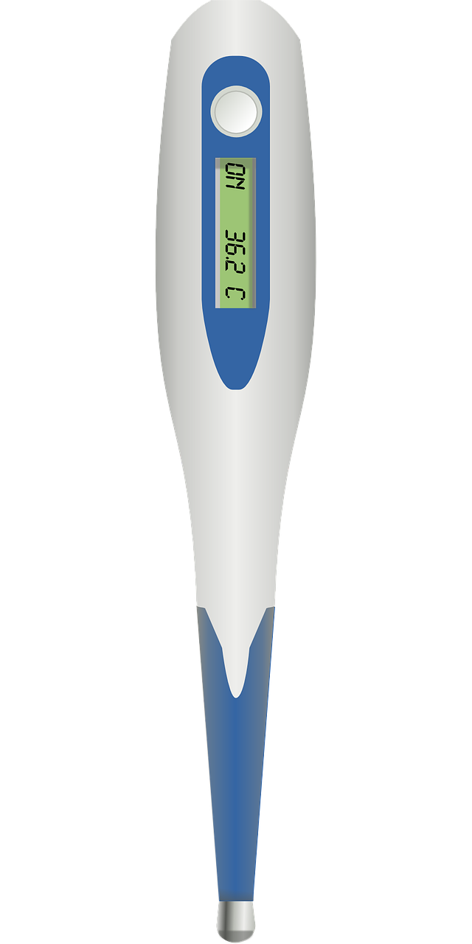
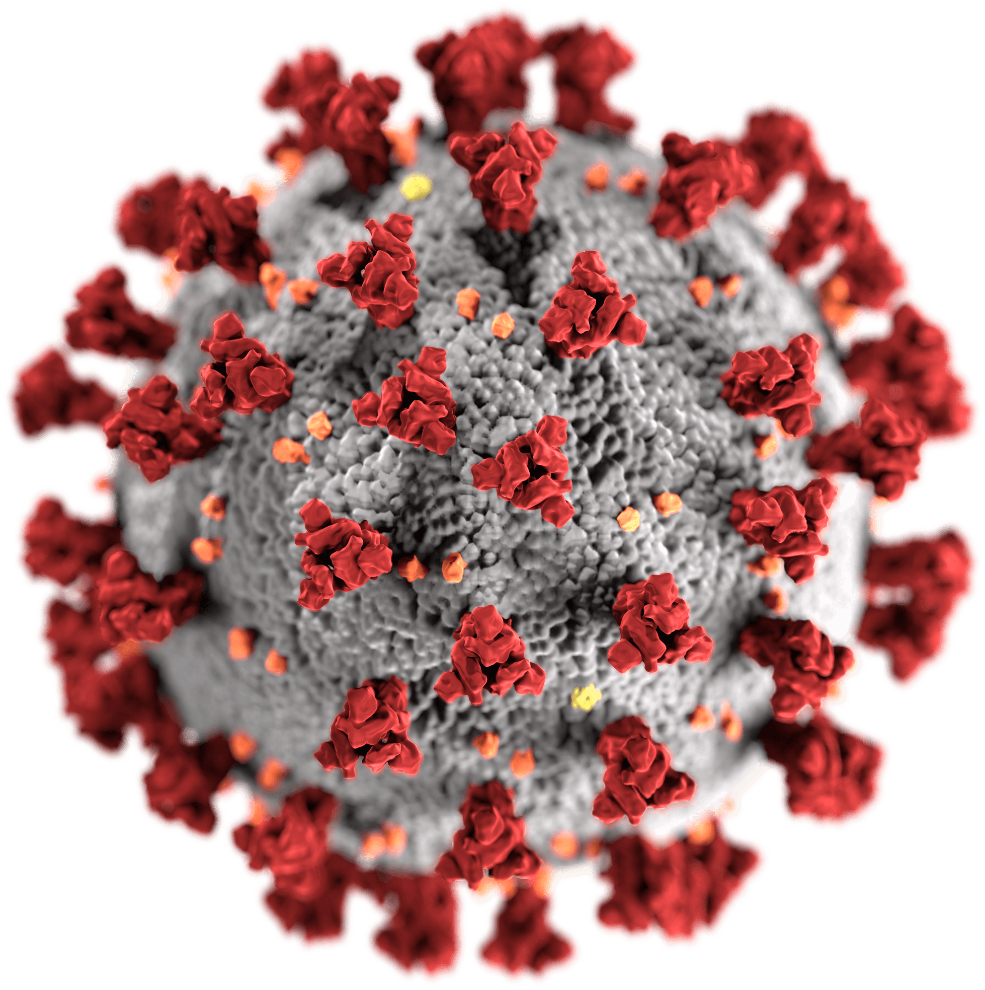
REQUIRED
IMMUNIZATIONS
for
High
School
College
Contact Nurse Kathy
kathleen.davis@ccisd.us
361-698-2431
Or look for me on Canvas!
RED
CORD
HERO
SOAP
Click around the clinic for information and forms!

